Slide 1
Monday, 4/4/22
Any Questions?
Exam 2
Project 5
Module Topic
Graphs | Duration: 2 Weeks
Activities 10.1 & 10.2

Slide 2
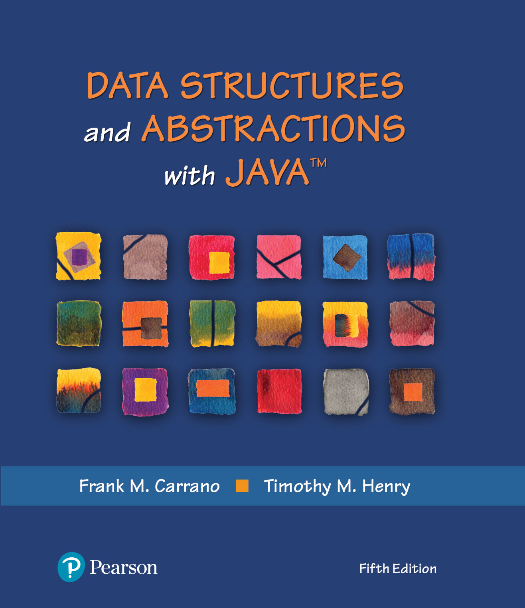
Module 20 - Graphs
Ch. 29 – Graphs
Ch. 30 – Graph Implementation

Slide 3
Video Notes
Graph Concepts
https://mediaplayer.pearsoncmg.com/assets/secs-vn-ch29a-graph-concepts
Graph Operations
https://mediaplayer.pearsoncmg.com/assets/secs-vn-ch29b-graph-operations
The Adjacency Matrix
https://mediaplayer.pearsoncmg.com/assets/secs-vn-ch30a-the-adjacency-matrix
Implementing Graph Operations
https://mediaplayer.pearsoncmg.com/assets/secs-vn-ch30b-implementing-graph-operations

Slide 4
Additional Videos
Floyd-Warshall (All Pairs Shortest Path)
https://www.youtube.com/watch?v=oNI0rf2P9gE
Graph Data Structure
https://www.youtube.com/watch?v=c8P9kB1eun4&list=RDCMUCSX3MR0gnKDxyXAyljWzm0Q&index=5
Graph Data Structure 4. Dijkstra’s Shortest Path Algorithm
https://www.youtube.com/watch?v=pVfj6mxhdMw
Graph Theory Algorithms
https://www.youtube.com/watch?v=DgXR2OWQnLc&list=PLDV1Zeh2NRsDGO4--qE8yH72HFL1Km93P
Topological Sort Algorithm | Graph Theory
https://www.youtube.com/watch?v=eL-KzMXSXXI

Slide 5
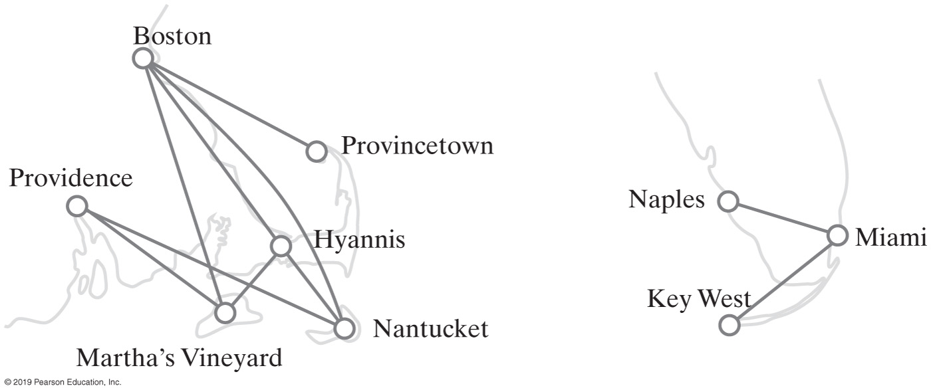
Google Maps | Airline Routes
How do I travel between Boston and Providence?
Undirected graphs
Directions of edges are not specified, two-way graphs
Notes:
Undirected graphs = two-way graphs

Slide 6
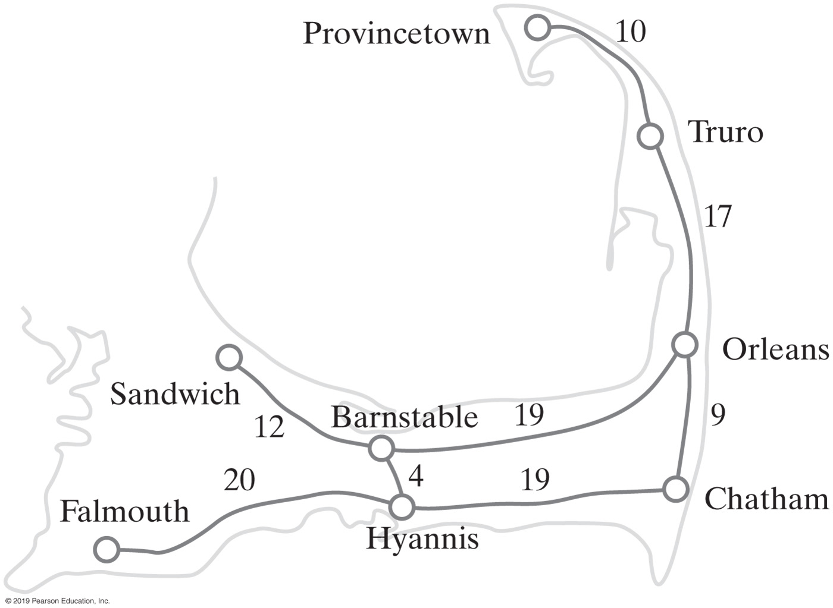
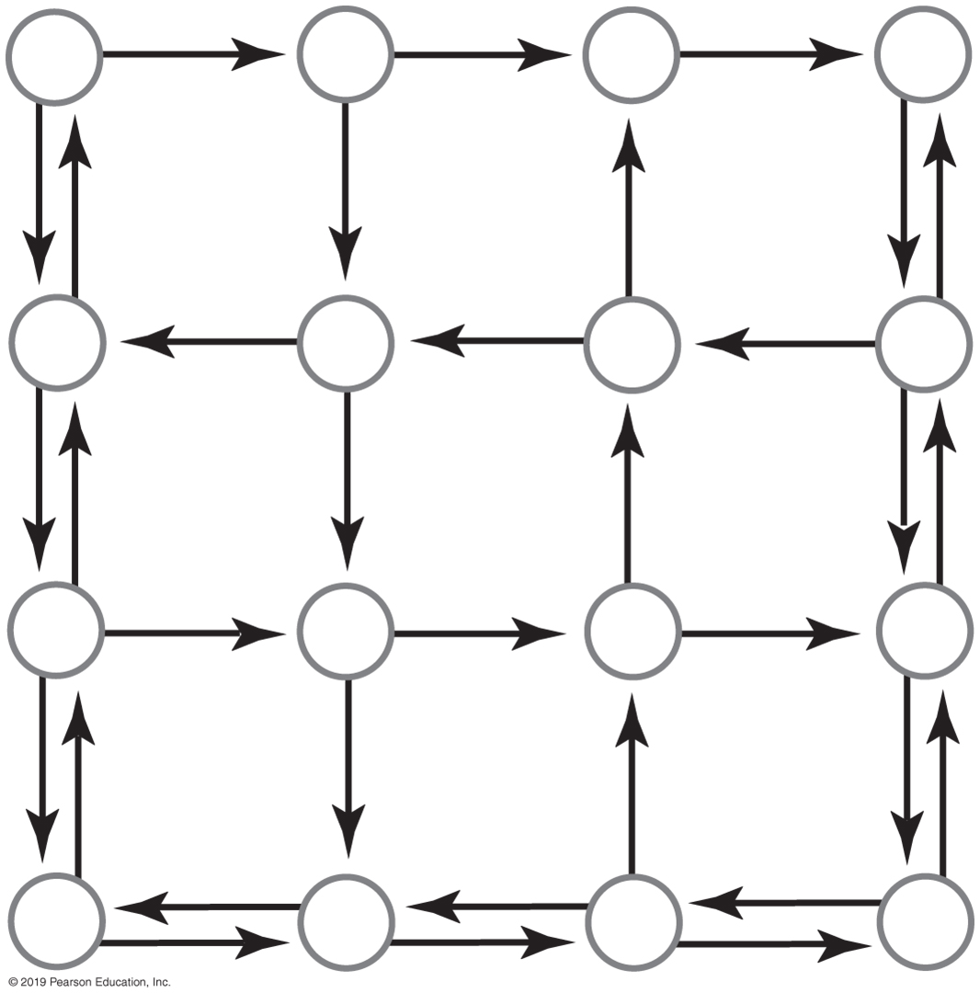
Directed & Weighted Graphs
A directed graph representing a portion of a city’s street map
A weighted graph
Notes:
Directed vs. undirected

Slide 7
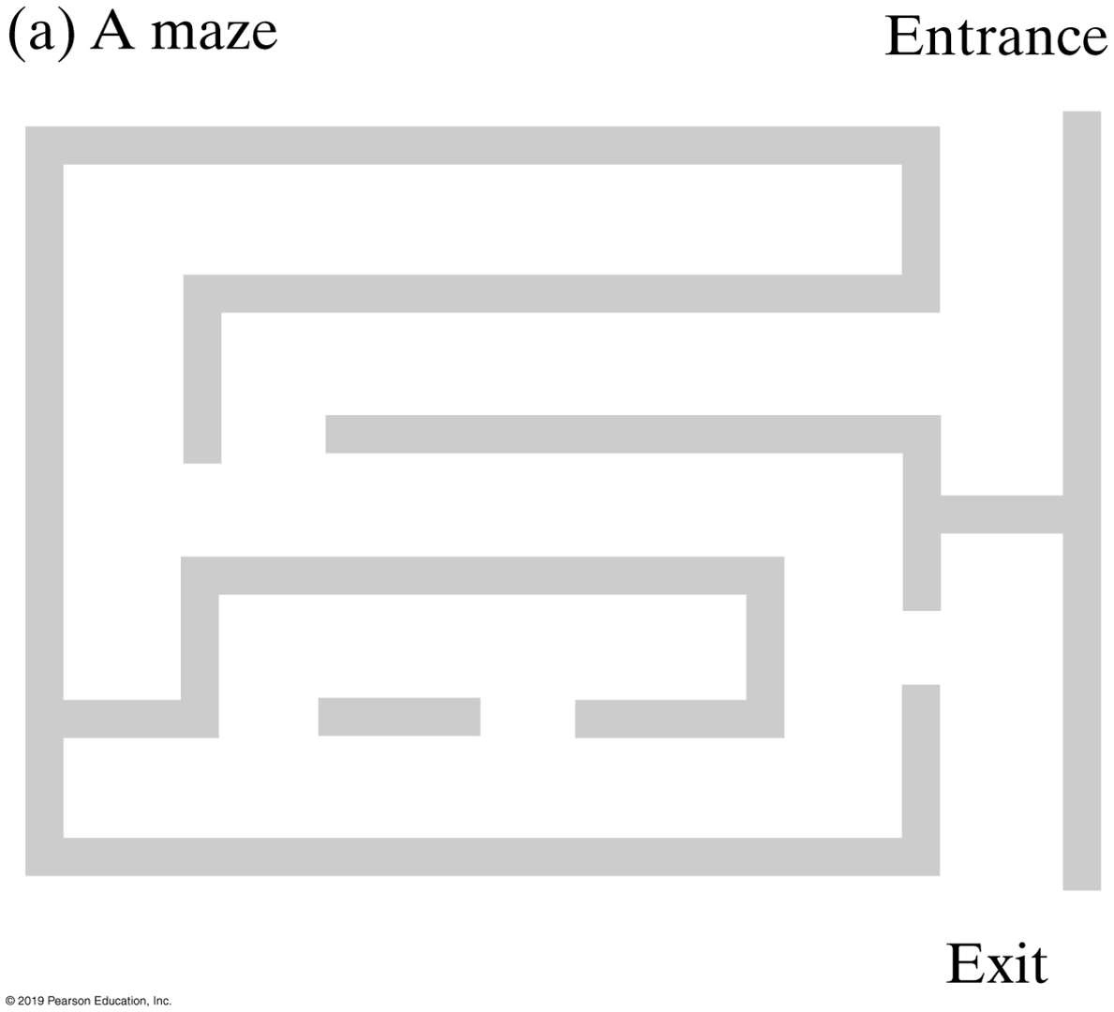
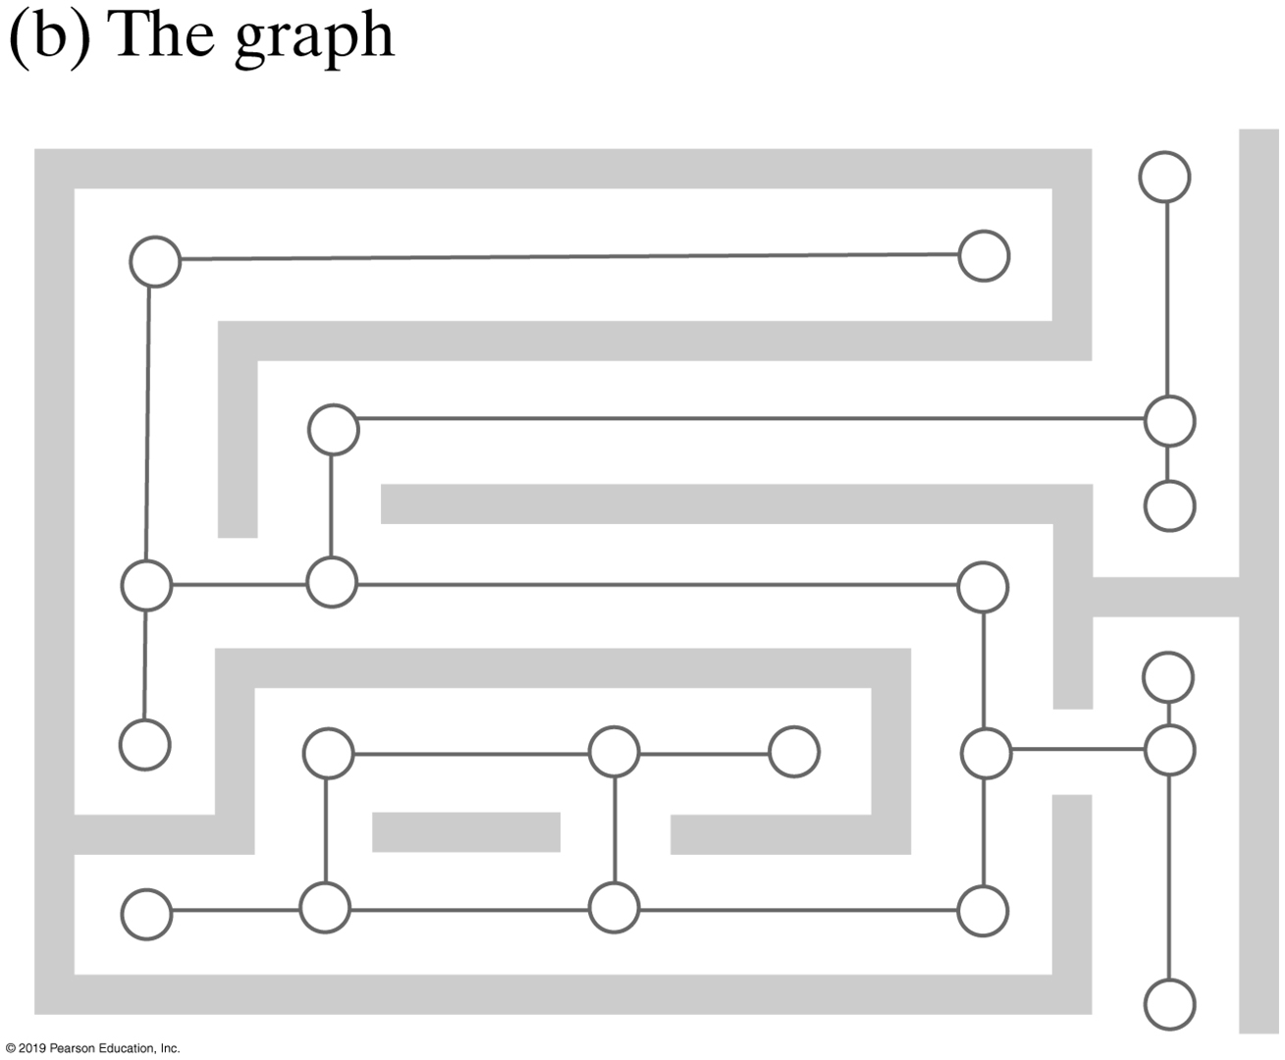
Maze | Example
How do we write a program to traverse a maze?

Slide 8
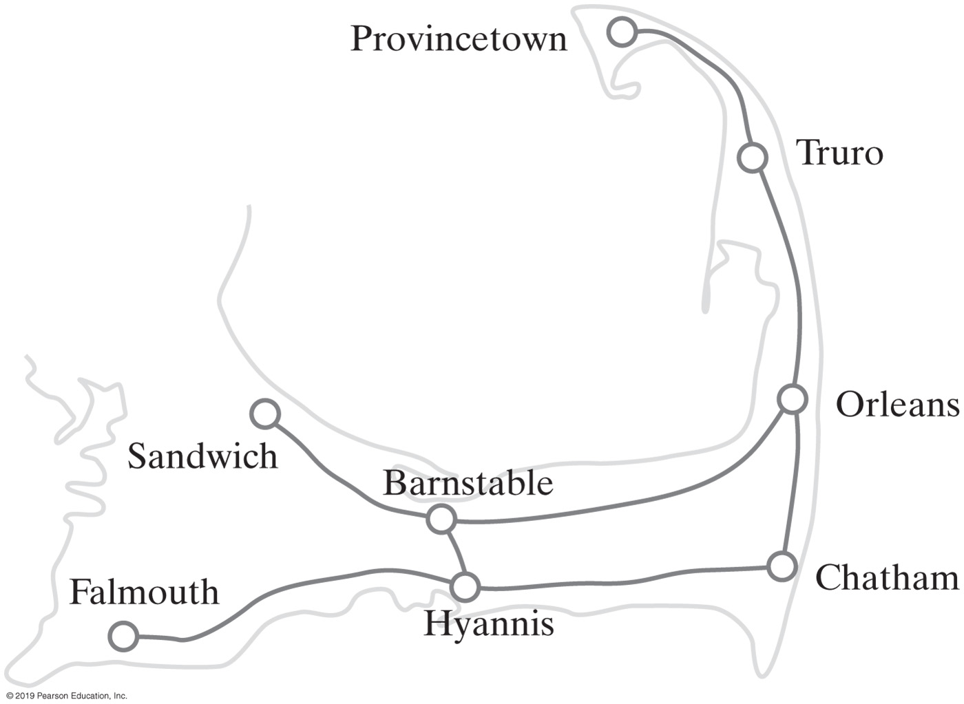
What’s a Graph?
Collection of distinct vertices (nodes) & distinct edges
A (road) map is a graph
Circles are vertices (nodes)
Lines are edges
A subgraph is a portion of a graph that is itself a graph
A portion of a road map
https://www.baeldung.com/java-graphs

Slide 9
Interesting Problems (1 of 2)
“Can any town be reached from any other town?”
Connected undirected graph problem
“Can we still reach every town if some of the roads are changed to one-way streets?”
Strongly connected digraph problem
“Which roads can be closed for repair such that travelers will still be able to reach every town?”
Spanning tree problem
“Which roads can be closed for repair such that every town can be reached and the total distance traveled is minimized?”
Minimum spanning tree problem
Notes:
Solutions Involving Graphs

Slide 10
Interesting Problems (2 of 2)
“What is the route that minimizes the mileage traveled between two towns?”
Shortest path problem
“Is there a route we can travel such that we pass through each town once but never visit any town twice?”
“What is the shortest route to visit all towns once and return back to the starting town?”
Traveling salesman problem

Slide 11
Graphs
Relationships between graphs vs. trees and linked lists
A tree is a graph
A linked list is a graph
A
C
B
A
B
C
A
A
B
C
B
C
A
5
3
A
B
C
B
C
Notes:
What did you notice?
A linked list is a graph, and a tree is a graph; but not vice versa

Slide 12
Graph Characteristics
Edges that make graphs distinctive (vs. trees …)
Edges can connect any two nodes (in a graph)
Edges can be bidirectional
Edges can store information (weights)
A vertex (node) need not be adjacent to any other
A
A
A
A
5
3
B
C
B
C
B
C
B
C

Slide 13
Additional Graph Characteristics
A graph is a set of vertices and edges that connect them: A, B, C, and e1, e2
Directed (digraph), weighted graphs
Adjacent vertices are connected by an edge: A and B, A and C are adjacent, but B and C are not adjacent
A
e1
e2
B
C
A
A
A
21
10
21
80
B
C
B
C
B
C
A
B
C
Notes:
Directed graph: directions are involved
Why do we care about adjacent vertices?

Slide 14
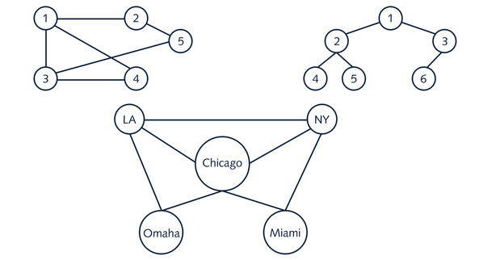
Undirected Graphs
Can I get to NY from Omaha?
Notes:
Undirected graphs: bidirectional

Slide 15
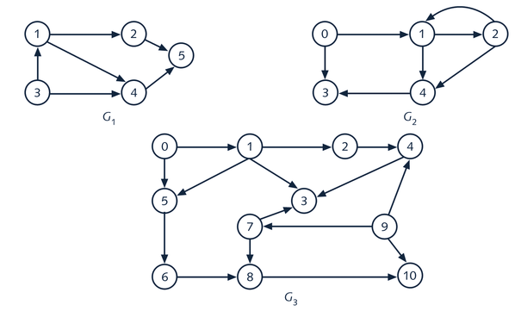
Directed Graphs (DiGraphs)
Notes:
G1: Going from 1 to 2 okay; but not 2 to 1

Slide 16
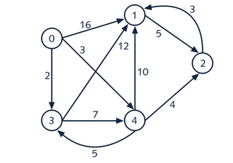
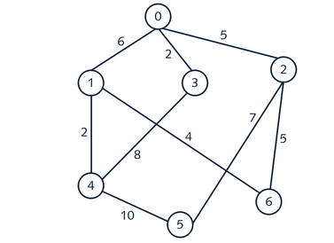
Weighted Graphs
“Best” way to travel between two end points
Notes:
Think about the edges

Slide 17
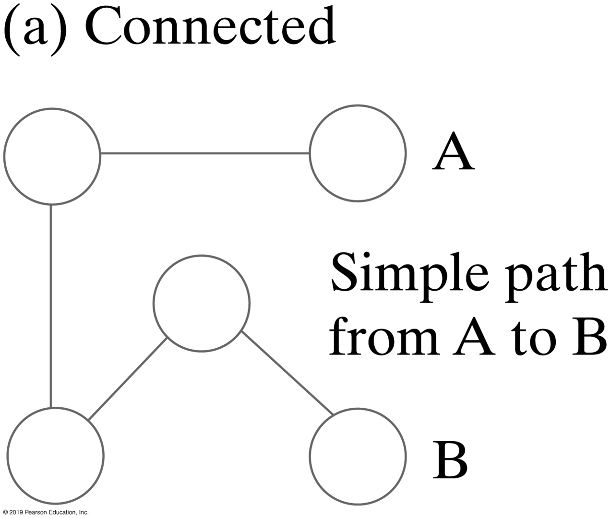
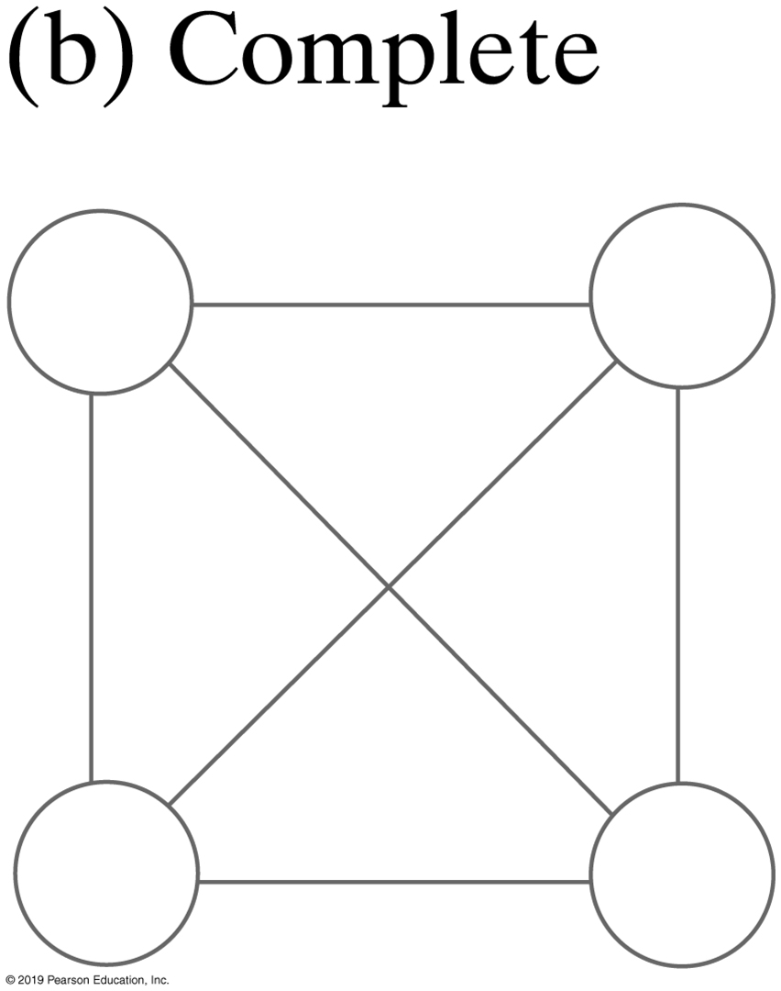
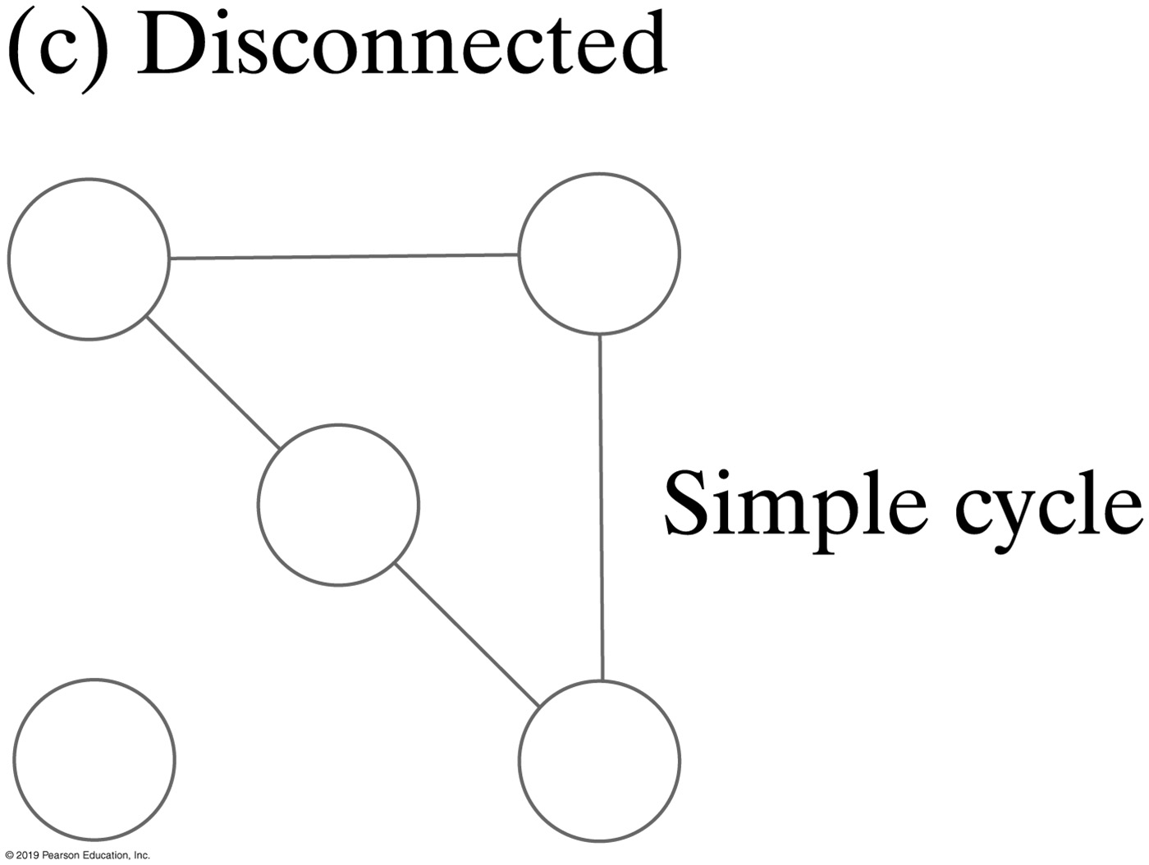
Graphs (Connected, Complete or Disconnected)
Undirected graphs

Slide 18
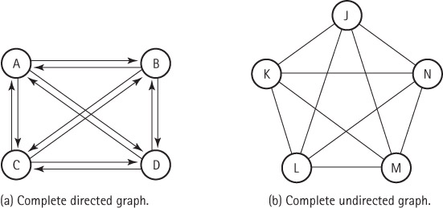
Complete Graphs

Slide 19

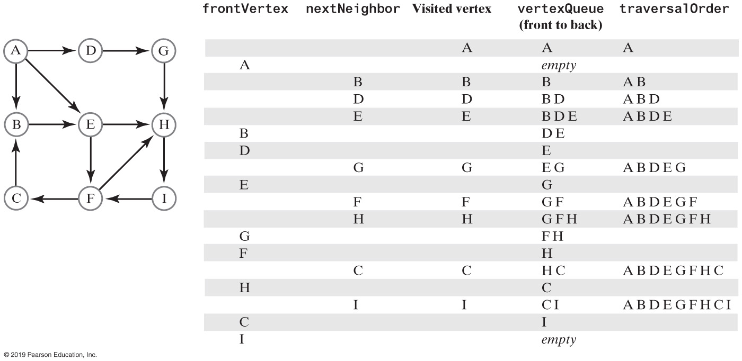
Adjacency | Directed Graphs
Vertex A is adjacent to vertex B, but B is not adjacent to A
Notes:
First Example: B -> A, NOT A -> B

Slide 20
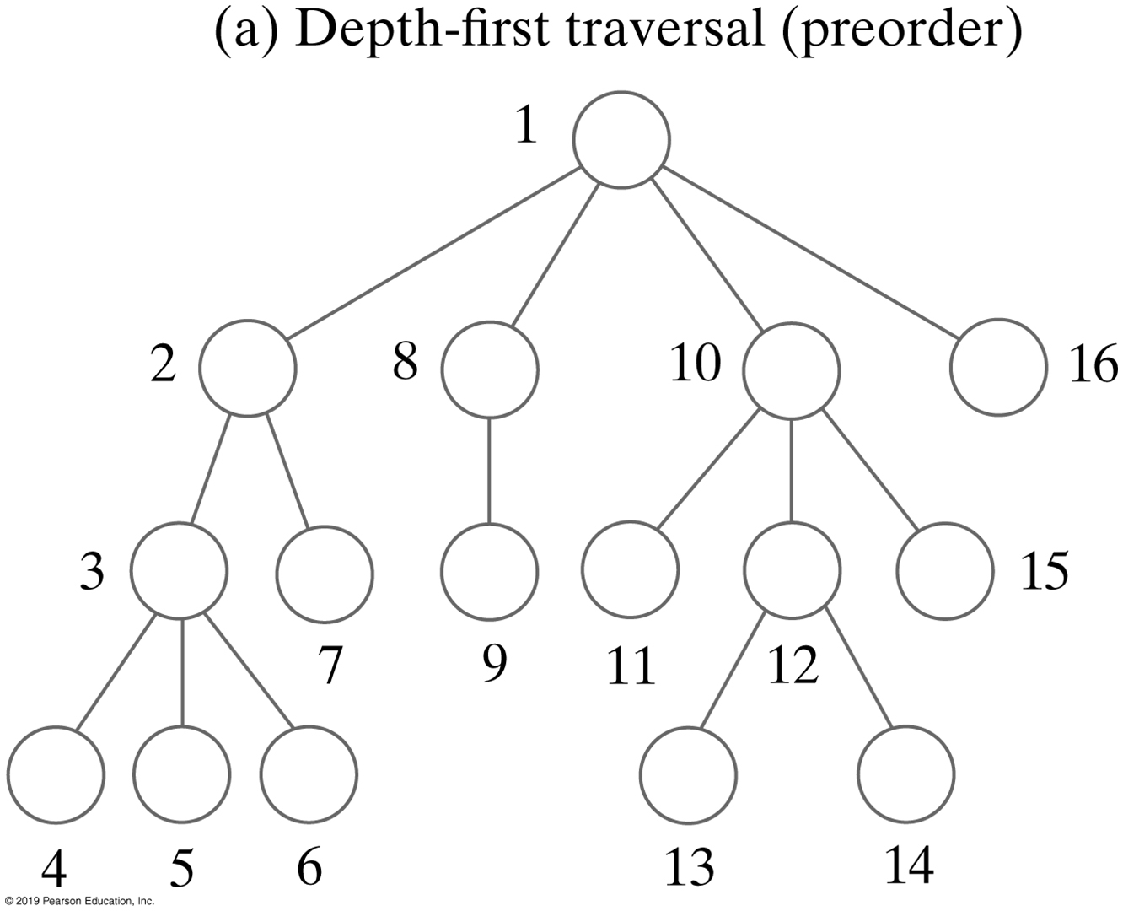
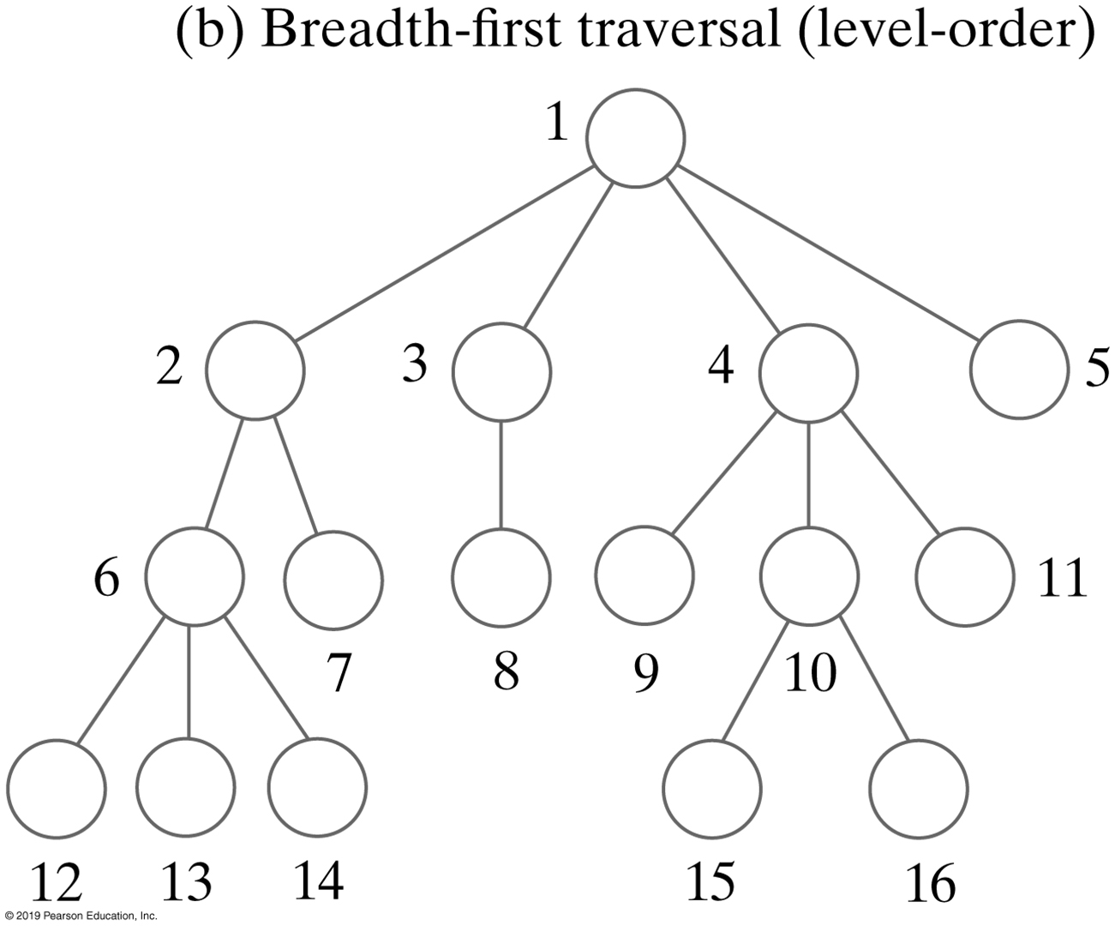
Common Graph Traversal Orders
More complicated than traversing a list or a binary tree
Any node in a graph can be the starting point for the traversal
Many choices for which node to visit next

Slide 21
Depth-First (Pre-order) Traversal
All of a vertex’s decedents are visited before any of its siblings are visited
A vertex’s siblings are all nodes adjacent to the node previously visited
What’s the traversal order?
Who are the decedents?
2
1
0
3
4
Notes:
Depth first | pre-order
Starting at 3, 4, 0 & 1 are siblings to each other
Therefore, 2 will always follow 1 for DFT

Slide 22
Depth-First Traversal
All of a vertex’s decedents are visited before any of its siblings are visited
A vertex’s siblings are all nodes adjacent to the node previously visited
Traversal order: 3, 4, 0, 1, 2
2
Descendent of vertex 1
1
Arbitrary starting vertex (no node visited before it)
0
3
Decedents of vertex 3, all siblings
4
Notes:
3, 4, 1, 2, 0
3, 0, 4, 1, 2
3, 1, 2, 0, 4

Slide 23
Depth-First Traversal Algorithm
Use a stack to save unvisited siblings while descendants are visited
Ensure they will be visited after any decedents that are subsequently pushed onto the stack
Vertices are only pushed once
2
0 1 2 3 4
0 0 1 0 1 1
1 1 0 1 1 0
2 0 1 0 0 0
3 1 1 0 0 1
4 1 0 0 1 0
1
0
3
4
Visited order V₃ V₄ V₁ V₂ V₀
The stack after the visit
V₄
V₁
V₀
V₁
V₀
V₂
V₀
V₀
Adjacency Matrix
The stack operations after Push V₀ Pop Push V₂ Pop
The visit Push V₁ Pop
Push V₄
Pop
Notes:
3, 4, 1, 2, 0
3, 0, …
3, 0, …
3, 1, …
3,1, …

Slide 24
Breadth-First Traversal (1 of 3)
Level order traversal
All of a vertex’s siblings are visited before any of its descendants are visited
A vertex’s siblings are all nodes adjacent to the node previously visited
What’s the traversal order?
2
1
0
3
4

Slide 25
Breadth-First Traversal (2 of 3)
All of a vertex’s siblings are visited before any of its descendants are visited
A vertex’s siblings are all nodes adjacent to the node previously visited
Traversal order: 3, 0, 1, 4, 2
2
Descendent of vertex 1
1
Arbitrary starting vertex (no node visited before it)
0
3
Decedents of vertex 3, all siblings
4
Notes:
3 is the starting vertex for these examples
Follow by
4, 0, 1; or
4, 1, 0; or
0, 1, 4; …
Finally visit 2 (always the last visited vertex for this example)

Slide 26
Breadth-First Traversal (3 of 3)
Use a queue to save unvisited siblings
They will be visited before any decedents that are subsequently added to the queue
Vertices are only enqueued once
2
0 1 2 3 4
0 0 1 0 1 1
1 1 0 1 1 0
2 0 1 0 0 0
3 1 1 0 0 1
4 1 0 0 1 0
1
0
3
4
Visited order V₃ V₀ V₁ V₄ V₂
The queue after the visit
V₀
V₁
V₄
V₁
V₄
V₄
V₂
V₂
Adjacency Matrix
The queue operations after Enqueue V₀ Dequeue Dequeue Dequeue
The visit Enqueue V₁ Enqueue V2 Enqueue V₄
Dequeue

Slide 27
Activity | Breadth-First Traversal
What is the traversal order, starting from A?
Notes:
Solution next page

Slide 28
Activity | Solution
What is the traversal order, starting with A?
This is one of numerous solutions
Traversal: visit each vertex once
Notes:
A, B, D, E, …
A, D, E, B, …
A, E, D, B, …
A, B, E, D, …

Slide 29
Breadth-First Traversal
A trace of a breadth-first traversal beginning at vertex A of a directed graph

Slide 30
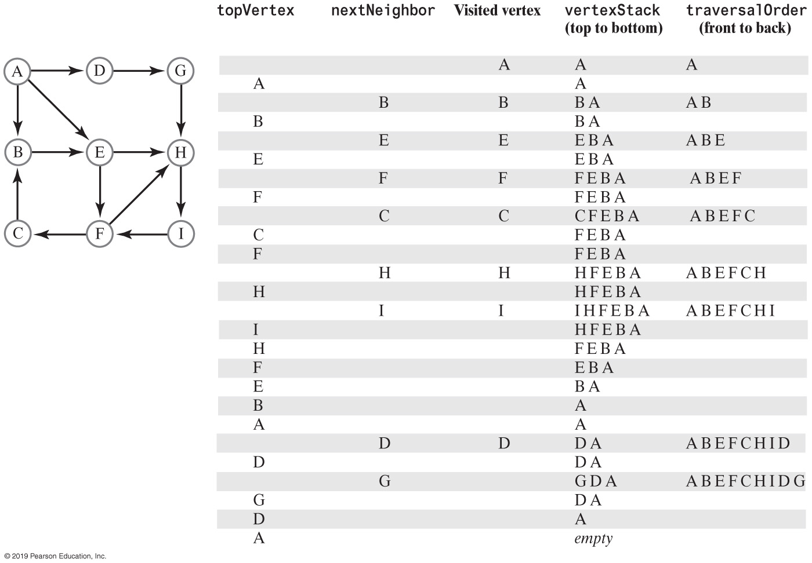
Activity | Depth-First Traversal
What is the traversal order, starting with A?

Slide 31
Activity | Solution
A trace of a depth-first traversal beginning at vertex A of a directed graph

Slide 32
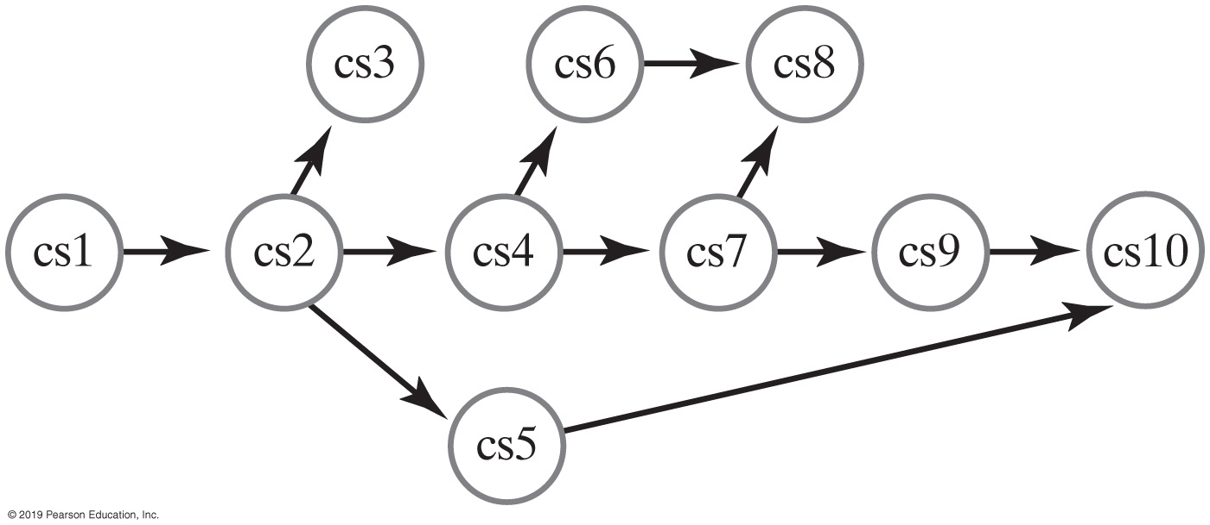
Course Prerequisites
Notes:
CS1 (140) MUST be completed first
Once CS2 is completed, then what?

Slide 33
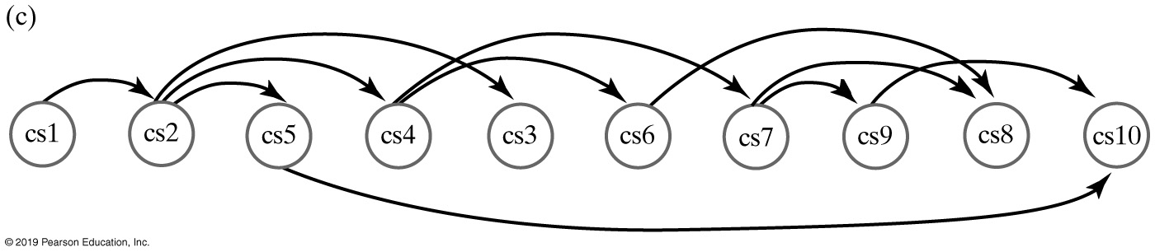
Topological Ordering
Three topological orders available starting with CS2

Slide 34
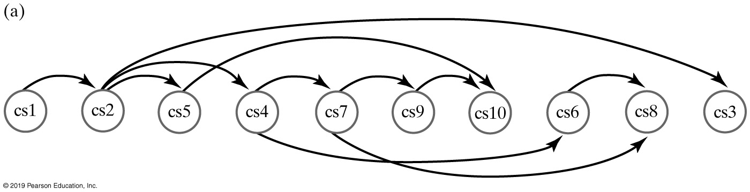
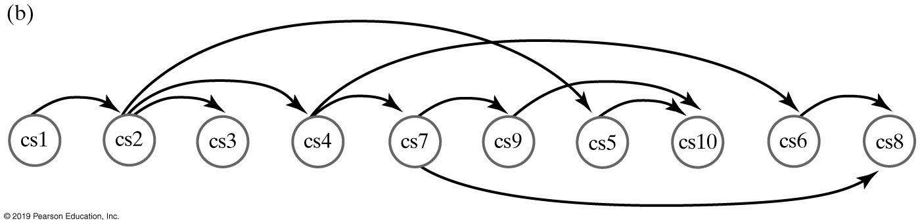
Topological Ordering
Figure 29-8
Three topological orders for the graph in Figure 29-8

Slide 35
Topological Order
Schedule a sequence of tasks (or jobs) based on their dependencies
Tasks are represented by vertices, and there is an edge from x to y if task x must be completed before task y can be started
Topological sort gives an order in which to perform the jobs.
PERT technique for scheduling in project management
https://en.wikipedia.org/wiki/Topological_sorting

Slide 36
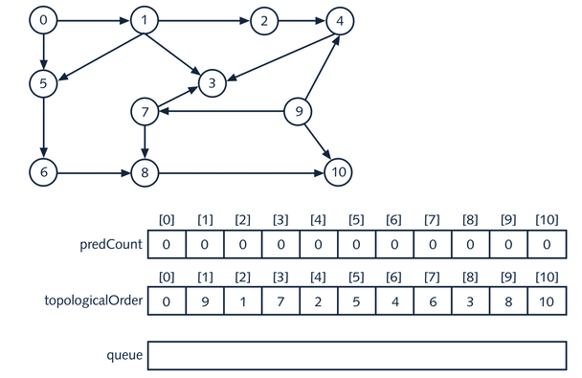
Topological Order (Breadth-First)
What should the topological order be?
There are dependencies, what should we work on first?
Notes:
0 is a good starting point, then what?

Slide 37
Topological Order (Solution)
A desired topological order (solution) of this directed graph
Notes:
Do Task 0 first, follow by Task 9, and so on …
Why? How?

Slide 38
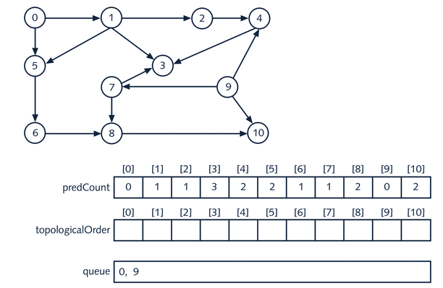
Topological Order (Dependencies)
predCount for [0] and [9] are 0 – put in queue
Notes:
PreCount – predecessor count
Tasks 0, 9 has no predecessors
Task 3 has 3 predecessor (Tasks 1, 4 & 7)
Work on all Tasks with 0 predecessor first (Task 0, then Task 9)

Slide 39
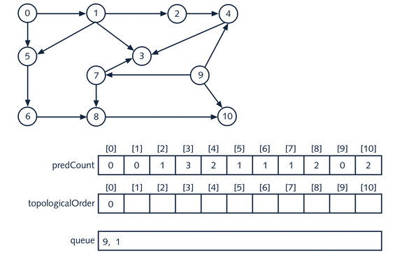
Topological Order
1. Take [0] out of queue, put in topological order
2. Delete 1 from all successors of [0] : [1] and [5]
3. Place any new indexes of predCount that are now 0 on the queue

Slide 40
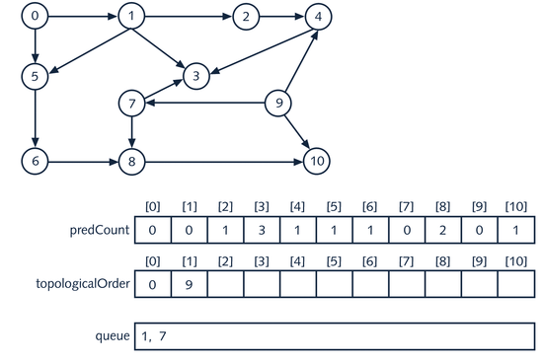
Topological Order
1. Take [9] out of queue, put in topological order
2. Delete 1 from all successors of [9] : [4], [7] and [10]
3. Place any new indexes of predCount that are now 0 on the queue

Slide 41
Breadth First Topological Order
Create the array predCount & initialize it
predCount[i] is the number of predecessors of the vertex v_{i}
Initialize the queue to all those vertices v_{k} so that predCount[k] is zero
Clearly, queue is not empty because the graph has no cycles
While the queue is not empty
Remove the front element, u, of the queue
Put u in the next available position, say topologicalOrder[topIndex], and increment topIndex
For all the immediate successors w of u
Decrement the predecessor count of w by 1
if the predecessor count of w is zero, add w to queue

Slide 42
Topological Order | DiGraph
Let G be a directed graph and V(G) = {v₁, v₂, ..., v_{n}}, where n > 0
A topological ordering of V(G) is a linear ordering vi1, vi2, ..., vin of the vertices such that if vij is a predecessor of vik, j ≠ k, 1 <= j <= n, and 1 <= k <= n, then vij precedes vik, that is, j < k in this linear ordering
We assume the graph has no cycles
There exists a vertex u in G such that u has no predecessor (the beginning)
There exists a vertex v in G such that v has no successor (the end)
We will use a breadth first traversal

Slide 43
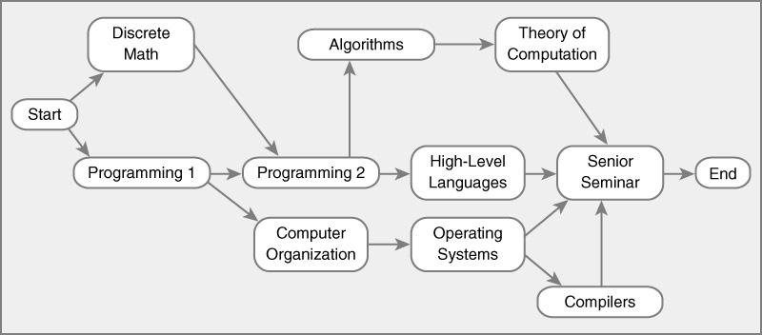
Learning Activity
List the nodes of the graph in a breadth first topological ordering.
Notes:
Be sure to work on this
My To Do

Slide 44
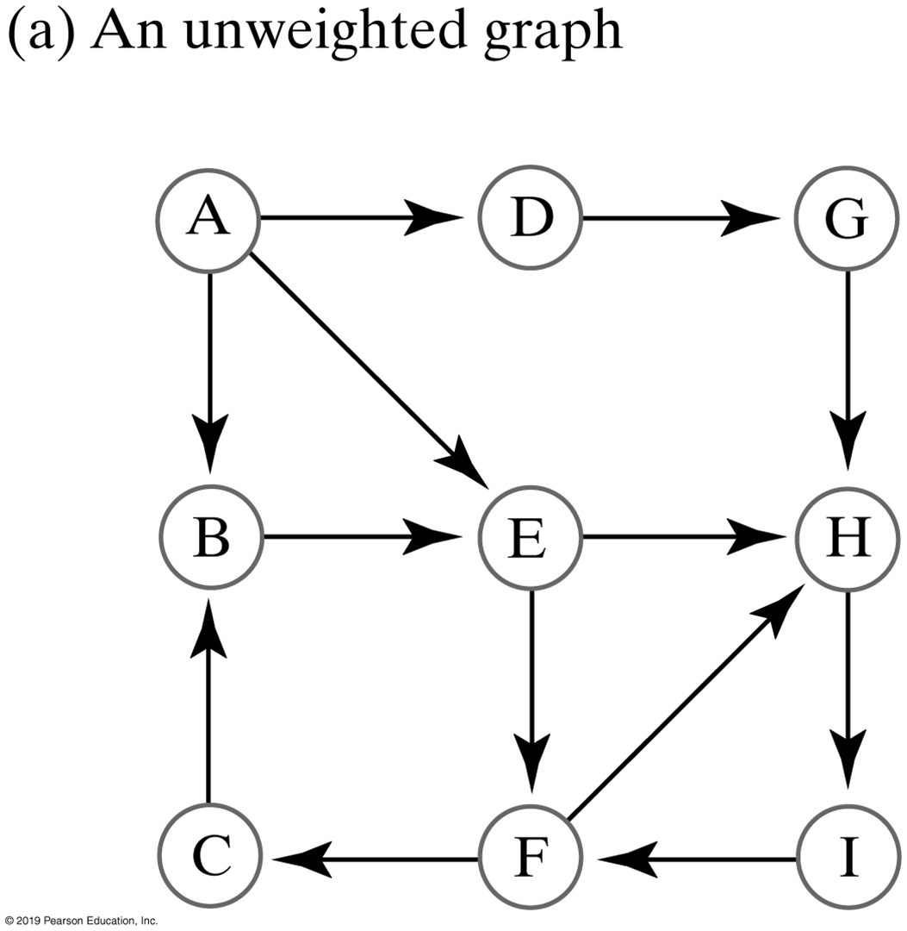
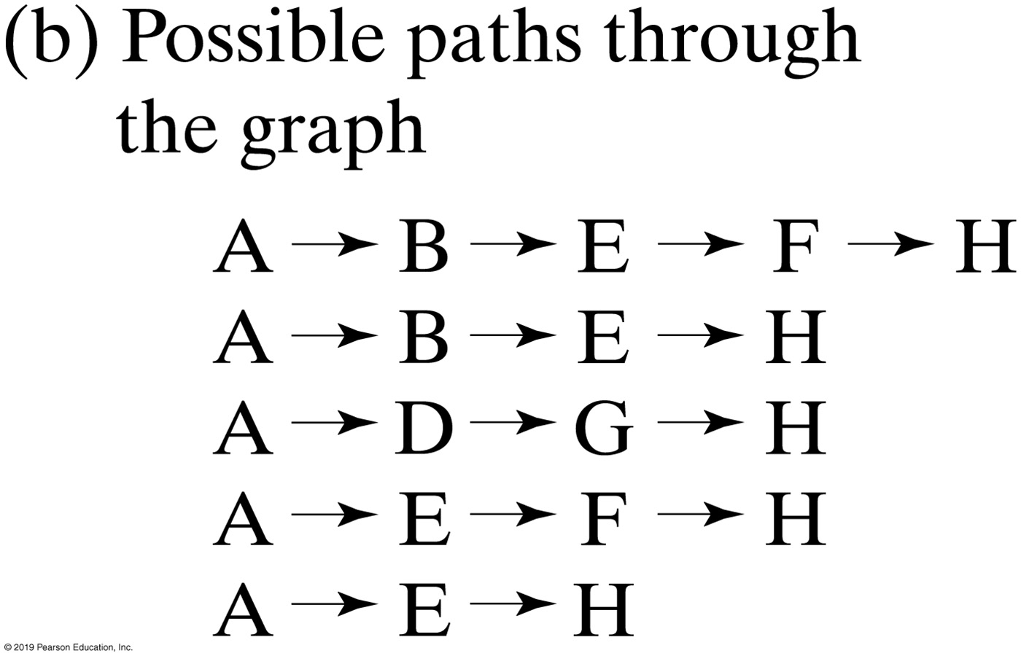
Shortest Path (Unweighted Graph)
What’s the “most efficient” way to go from A to H?
Possible paths from vertex A to vertex H
Notes:
Traveling from A to H

Slide 45
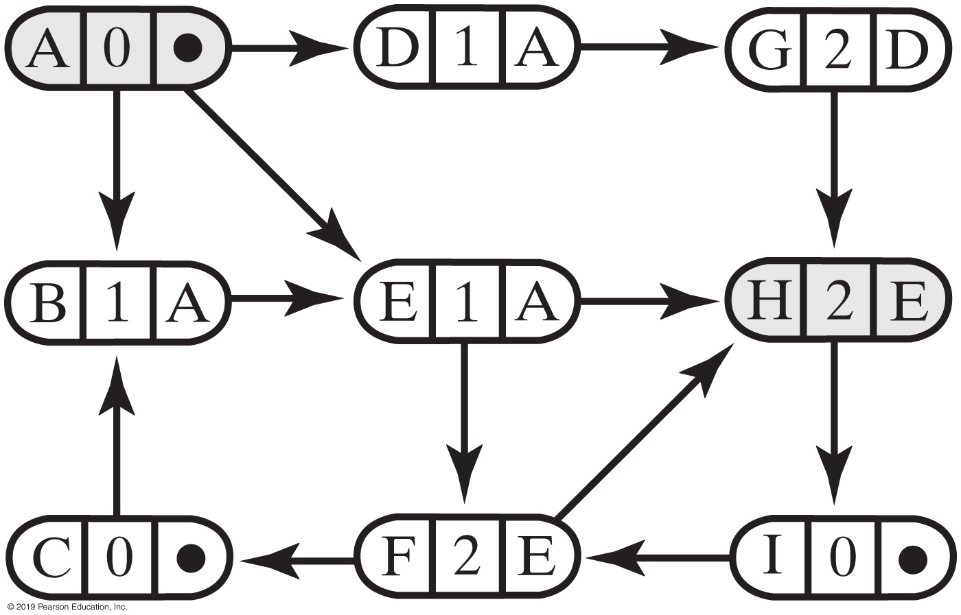
Shortest Path (Unweighted Graph)
The graph after the shortest-path algorithm has traversed from vertex A to vertex H
Notes:
From A to D : 1
From A to F : 2

Slide 46
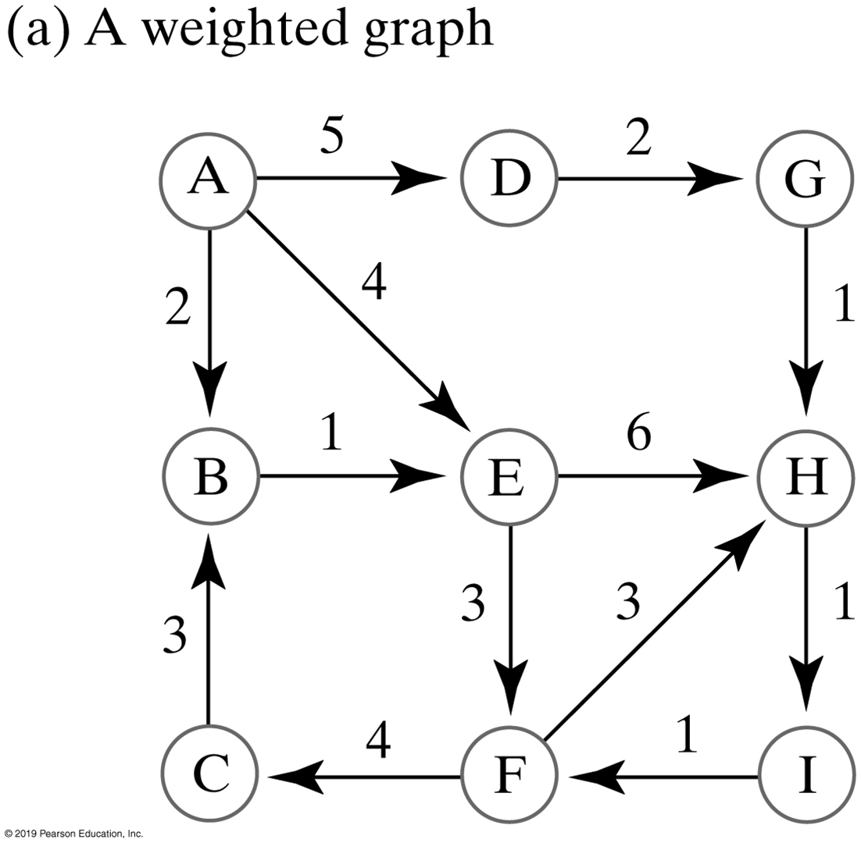
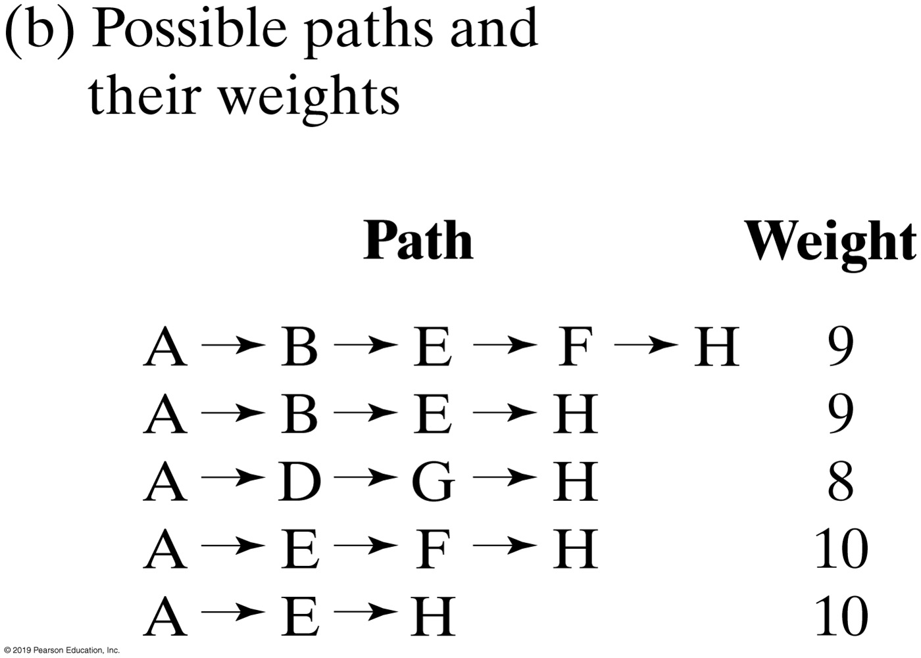
Shortest Path (Weighted Graph)
A weighted graph and the possible paths from vertex A to vertex H
Notes:
Edges are now a factor

Slide 47
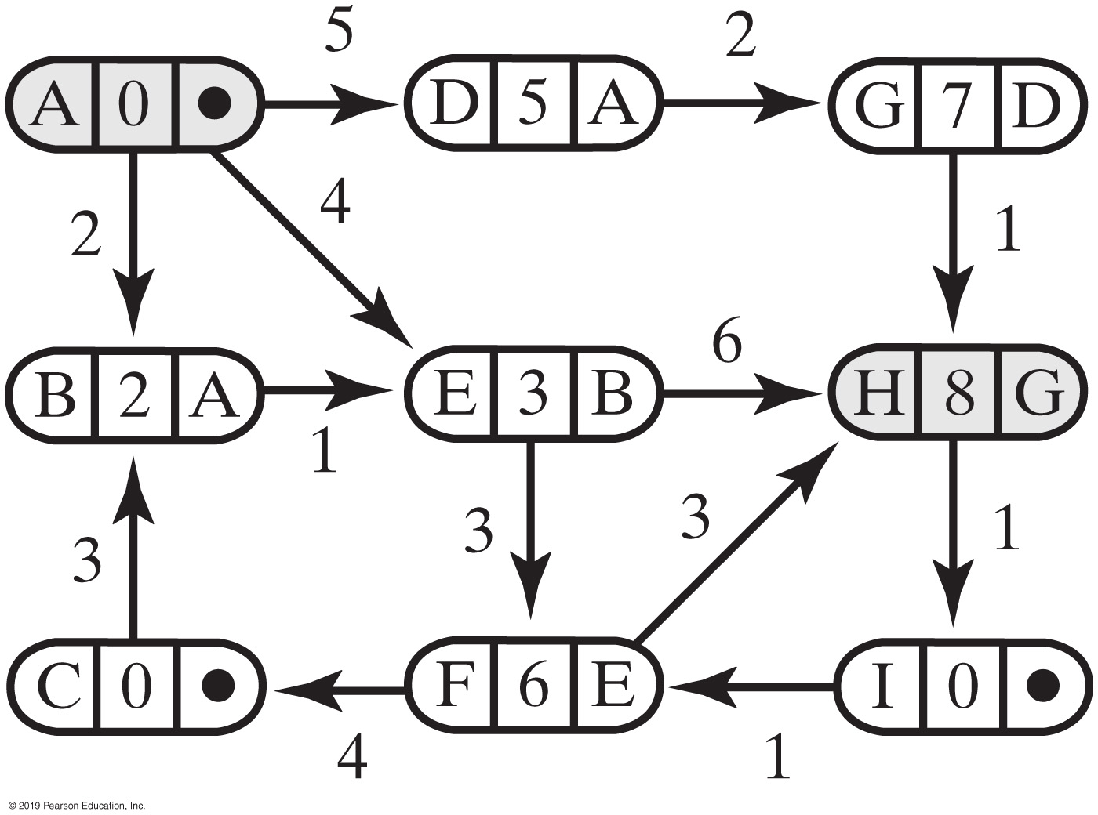
Shortest Path (Weighted Graph)
The graph after finding the cheapest path from vertex A to vertex H

Slide 48
Adjacency Matrix vs. Adjacency List
Graph vs. Tree implementations
Vertices & edges
Common implementations
Array | adjacency matrix
Typically a two-dimensional array
List | adjacency list
Linked nodes
Why “adjacency” list (or matrix)?
We just don’t know where to go for “next”
Tree, linked list, array

Slide 49
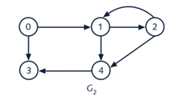
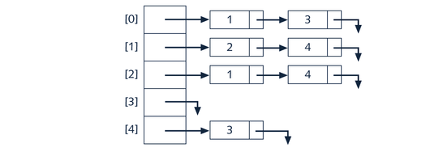
Adjacency List | “Next”
vertex[0]
0
vertex[1]
1
vertex[2]
2
vertex[3]
3
vertex[4]
4
Notes:
From 0, I can go to 1 or 3 next

Slide 50
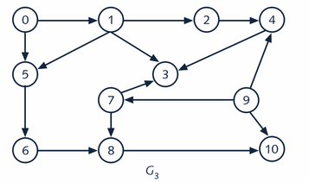
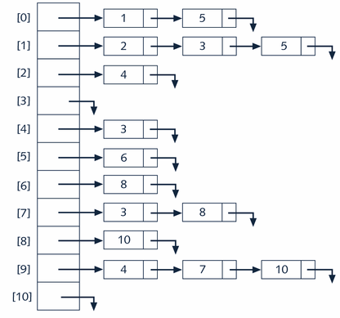
Adjacency List for G3
vertex[0]
0
vertex[1]
1
vertex[2]
2
vertex[3]
3
vertex[4]
4
. . .
vertex[10]
10

Slide 51
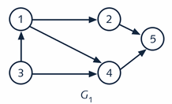
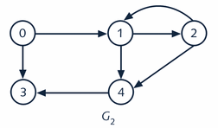
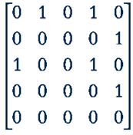
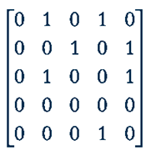
Adjacency Matrix (2D-Array Representation)
edge
edge
vertex[0]
1
vertex[0]
0
vertex[1]
2
vertex[1]
1
vertex[2]
3
vertex[2]
2
vertex[3]
4
vertex[3]
3
vertex[4]
5
vertex[4]
4
Notes:
1, 2, 3, 4 & 5 are “names” of vertices
Array (of vertices) + 2-D array (“edge”)
What’s the point with “adjacency” matrix or list

Slide 52
“Real World” Example
Vertex array is an array of node references
Edge array is a two dimensional array
Called the adjacency matrix
0 in edge[i][j] indicates no edge from vertex i to vertex j
Symmetric for undirected graphs
0 1 2 3 4
0 0 1 0 1 1
1 1 0 1 1 0
2 0 1 0 0 0
3 1 1 0 0 1
4 1 0 0 1 0
26
edge
82
Philidelphia
vertex[0]
26
600
vertex[1]
600
New York
vertex[2]
1000
1000
vertex[3]
44
Boston
2
vertex[4]
300
44
1
Los Angeles
300
0
Houston
3
4
Notes:
What are the 26,600, 1000, 44 and 300?
What is the adjacency matrix for?

Slide 53
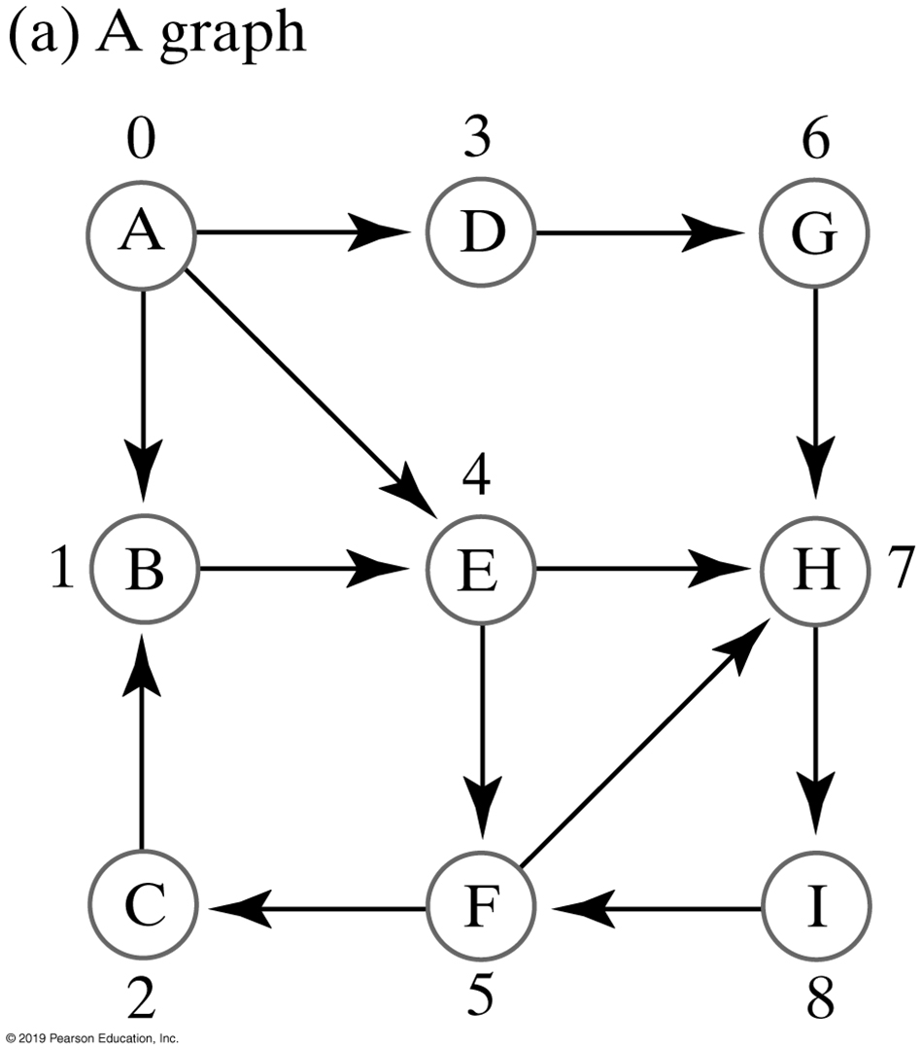
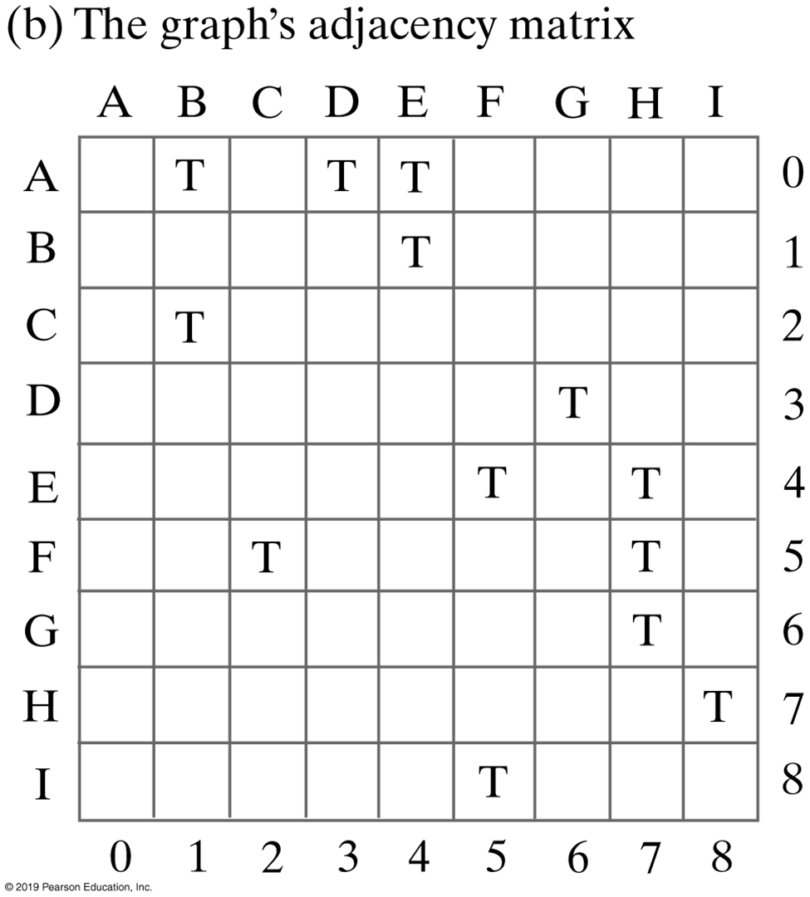
Another Example
Notes:
Unweighted, Directed Graph & Adjacency Matrix

Slide 54
Activity | Take Home
Derive the adjacency matrix for the following graph
2
1
0
3
4

Slide 55
Activity | Solution
0 1 2 3 4
0 0 1 0 1 1
1 1 0 1 1 0
2 0 1 0 0 0
3 1 1 0 0 1
4 1 0 0 1 0
26
edge
82
Philidelphia
vertex[0]
26
600
vertex[1]
600
New York
vertex[2]
1000
1000
vertex[3]
44
Boston
2
vertex[4]
300
44
1
Los Angeles
300
0
Houston
3
4
Notes:
Same adjacency matrix, regardless where you start

Slide 56
Preview: World Tour
A
B
3
16
9
4
F
5
C
8
E
6
1
2
H
G
7
Determine a set of flights that connects all cities (world tour)
Notes:
I like to visit all cities, what’s the best way to do so?
Is there a connectivity between these cities

Slide 57
Connectivity
A
B
3
16
9
4
5
F
C
8
E
6
1
2
G
H
7
Solution for the Flight Paths (previous slide)
Connectivity vs. shortest path | Going from A to E
Notes:
The spanning tree of a graph (G) is a subset of G that covers all of its vertices using the minimum number of edges
https://www.educative.io/edpresso/what-is-a-spanning-tree

Slide 58
Code & Pseudocode
Watch the video notes first

Slide 59
Java Interfaces for the ADT Graph (Part 1)
/** An interface of methods providing basic operations for directed
and undirected graphs that are either weighted or unweighted. */
public interface BasicGraphInterface<T>
{
/** Adds a given vertex to this graph.
@param vertexLabel An object that labels the new vertex and is
distinct from the labels of current vertices.
@return True if the vertex is added, or false if not. */
public boolean addVertex(T vertexLabel);
/** Adds a weighted edge between two given distinct vertices that
are currently in this graph. The desired edge must not already
be in the graph. In a directed graph, the edge points toward
the second vertex given.
@param begin An object that labels the origin vertex of the edge.
@param end An object, distinct from begin, that labels the end
vertex of the edge.
@param edgeWeight The real value of the edge's weight.
@return True if the edge is added, or false if not. */
public boolean addEdge(T begin, T end, double edgeWeight);

Slide 60
Java Interfaces for the ADT Graph (Part 2)
/** Adds an unweighted edge between two given distinct vertices
that are currently in this graph. The desired edge must not
already be in the graph. In a directed graph, the edge points
toward the second vertex given.
@param begin An object that labels the origin vertex of the edge.
@param end An object, distinct from begin, that labels the end
vertex of the edge.
@return True if the edge is added, or false if not. */
public boolean addEdge(T begin, T end);
/** Sees whether an edge exists between two given vertices.
@param begin An object that labels the origin vertex of the edge.
@param end An object that labels the end vertex of the edge.
@return True if an edge exists. */
public boolean hasEdge(T begin, T end);
/** Sees whether this graph is empty.
@return True if the graph is empty. */
public boolean isEmpty();

Slide 61
Java Interfaces for the ADT Graph (Part 3)
/** Gets the number of vertices in this graph.
@return The number of vertices in the graph. */
public int getNumberOfVertices();
/** Gets the number of edges in this graph.
@return The number of edges in the graph. */
public int getNumberOfEdges();
/** Removes all vertices and edges from this graph
resulting in an empty graph. */
public void clear();
} // end BasicGraphInterface

Slide 62
Java Interfaces for the ADT Graph (Part 1)
/** An interface of methods that process an existing graph. */
public interface GraphAlgorithmsInterface<T>
{
/** Performs a breadth-first traversal of this graph.
@param origin An object that labels the origin vertex of the traversal.
@return A queue of labels of the vertices in the traversal, with
the label of the origin vertex at the queue's front. */
public QueueInterface<T> getBreadthFirstTraversal(T origin);
/** Performs a depth-first traversal of this graph.
@param origin An object that labels the origin vertex of the traversal.
@return A queue of labels of the vertices in the traversal, with
the label of the origin vertex at the queue's front. */
public QueueInterface<T> getDepthFirstTraversal(T origin);
/** Performs a topological sort of the vertices in this graph without cycles.
@return A stack of vertex labels in topological order, beginning
with the stack's top. */
public StackInterface<T> getTopologicalOrder();
An interface of operations on an existing graph

Slide 63
Java Interfaces for the ADT Graph (Part 2)
/** Finds the shortest-length path between two given vertices in this graph.
@param begin An object that labels the path's origin vertex.
@param end An object that labels the path's destination vertex.
@param path A stack of labels that is empty initially;
at the completion of the method, this stack contains
the labels of the vertices along the shortest path;
the label of the origin vertex is at the top, and
the label of the destination vertex is at the bottom
@return The length of the shortest path. */
public int getShortestPath(T begin, T end, StackInterface<T> path);
/** Finds the least-cost path between two given vertices in this graph.
@param begin An object that labels the path's origin vertex.
@param end An object that labels the path's destination vertex.
@param path A stack of labels that is empty initially;
at the completion of the method, this stack contains
the labels of the vertices along the cheapest path;
the label of the origin vertex is at the top, and
the label of the destination vertex is at the bottom
@return The cost of the cheapest path. */
public double getCheapestPath(T begin, T end, StackInterface<T> path);
} // end GraphAlgorithmsInterface
An interface of operations on an existing graph

Slide 64
Java Interfaces for the ADT Graph
/** An interface of methods that create, manipulate, and process a graph. */
public interface GraphInterface<T> extends BasicGraphInterface<T>,
GraphAlgorithmsInterface<T>
{
} // end GraphInterface
An interface for the ADT graph

Slide 65
Breadth-First Traversal
Algorithm getBreadthFirstTraversal(originVertex)
traversalOrder = a new queue for the resulting traversal order
vertexQueue = a new queue to hold vertices as they are visited
Mark originVertex as visited
traversalOrder.enqueue(originVertex)
vertexQueue.enqueue(originVertex)
while (!vertexQueue.isEmpty())
{
frontVertex = vertexQueue.dequeue()
while (frontVertex has a neighbor)
{
nextNeighbor = next neighbor of frontVertex
if (nextNeighbor is not visited)
{
Mark nextNeighbor as visited
traversalOrder.enqueue(nextNeighbor)
vertexQueue.enqueue(nextNeighbor)
}
}
}
return traversalOrder

Slide 66
Depth-First Traversal
Algorithm getDepthFirstTraversal(originVertex)
traversalOrder = a new queue for the resulting traversal order
vertexStack = a new stack to hold vertices as they are visited
Mark originVertex as visited
traversalOrder.enqueue(originVertex)
vertexStack.push(originVertex)
while (!vertexStack.isEmpty())
{
topVertex = vertexStack.peek()
if (topVertex has an unvisited neighbor)
{
nextNeighbor = next unvisited neighbor of topVertex
Mark nextNeighbor as visited
traversalOrder.enqueue(nextNeighbor)
vertexStack.push(nextNeighbor)
}
else // All neighbors are visited
vertexStack.pop()
}
return traversalOrder

Slide 67
Shortest Path (Unweighted Graph, Part 1)
Algorithm getShortestPath(originVertex, endVertex, path)
done = false
vertexQueue = a new queue to hold vertices as they are visited
Mark originVertex as visited
vertexQueue.enqueue(originVertex)
while (!done && !vertexQueue.isEmpty())
{
frontVertex = vertexQueue.dequeue()
while (!done && frontVertex has a neighbor)
{
nextNeighbor = next neighbor of frontVertex
if (nextNeighbor is not visited)
{
Mark nextNeighbor as visited
Set the length of the path to nextNeighbor to 1 + length of path to frontVertex
Set the predecessor of nextNeighbor to frontVertex
vertexQueue.enqueue(nextNeighbor)
}
if (nextNeighbor equals endVertex)
done = true
}
}

Slide 68
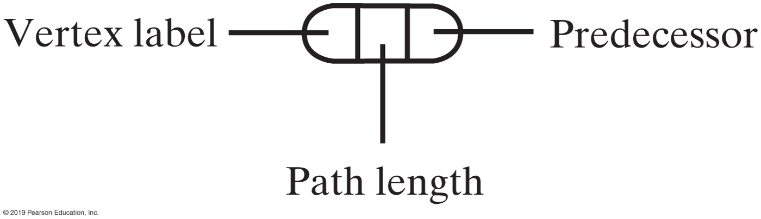
Shortest Path in an Unweighted Graph (Part 2)
// Traversal ends; construct shortest path
pathLength = length of path to endVertex
path.push(endVertex)
vertex = endVertex
while (vertex has a predecessor)
{
vertex = predecessor of vertex
path.push(vertex)
}
return pathLength
Algorithm to find shortest path
The data in a vertex

Slide 69
Shortest Path in a Weighted Graph (Part 1)
Algorithm getCheapestPath(originVertex, endVertex, path)
done = false
priorityQueue = a new priority queue
priorityQueue.add(new EntryPQ(originVertex, 0, null))
while (!done && !priorityQueue.isEmpty())
{
frontEntry = priorityQueue.remove()
frontVertex = vertex in frontEntry
if (frontVertex is not visited)
{
Mark frontVertex as visited
Set the cost of the path to frontVertex to the cost recorded in frontEntry
Set the predecessor of frontVertex to the predecessor recorded in frontEntry
if (frontVertex equals endVertex)
done = true
else
{

Slide 70
The Shortest Path in a Weighted Graph (Part 2)
while (frontVertex has a neighbor)
{
nextNeighbor = next neighbor of frontVertex
weightOfEdgeToNeighbor = weight of edge to nextNeighbor
if (nextNeighbor is not visited)
{
nextCost = weightOfEdgeToNeighbor + cost of path to frontVertex
priorityQueue.add(new EntryPQ(nextNeighbor, nextCost,
frontVertex))
}
}
}
}
}

Slide 71
The Shortest Path in a Weighted Graph (Part 3)
// Traversal ends; construct cheapest path
pathCost = cost of path to endVertex
path.push(endVertex)
vertex = endVertex
while (vertex has a predecessor)
{
vertex = predecessor of vertex
path.push(vertex)
}
return pathCost

